Slide 1
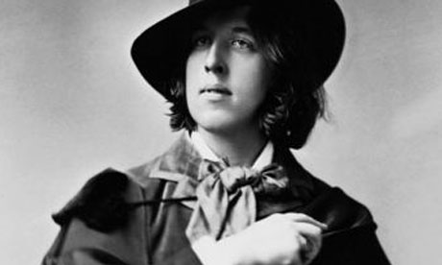
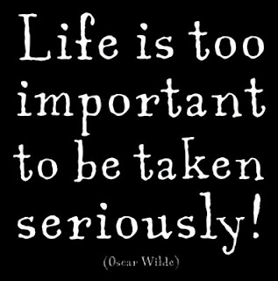
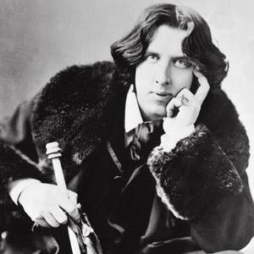
The
Importance of Being Earnest
~ Oscar Wilde

Slide 2
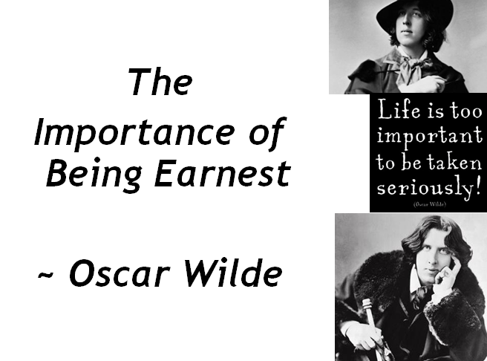
SOME KEY TERMS FOR THIS TEXT
irony,
word play (puns),
understatement,
overreaction or exaggeration,
repetition,
satire

Slide 3
Three types of irony | Verbal Dramatic Situational
Verbal Irony | This is the contrast between what is said and what is meant. Most sarcastic comments are ironic. For instance, the person who says, "Nice going, Einstein," isn't really paying anyone a compliment.

Slide 4
Three types of irony | Verbal Dramatic Situational
Dramatic Irony | This is the contrast between what the character thinks to be true and what we (the reader) know to be true. Sometimes as we read we are placed in the position of knowing more than what one character knows. Because we know something the character does not, we read to discover how the character will react when he or she learns the truth of the situation. It's when you know the boogeyman is hiding in the attic, but the hero of the movie doesn't know that. You want him to get a clue and stay away from the attic. "Don't open that door! Get out of the house!" The irony is that the hero thinks he is safe, when you know he's in danger. There is that element of contrast again.

Slide 5
Three types of irony | Verbal Dramatic Situational
Situational Irony | It is the contrast between what happens and what was expected. Irony of situation is often humorous, such as when a prank backfires on the prankster. It's the equivalent of a person spraying shaving cream in his own face when he was trying to spray his best friend.

Slide 6
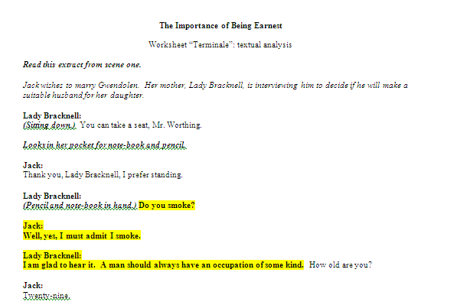
Look at (and watch) the following short scene.
This scene is typical of Wilde’s humour and style.

Slide 7
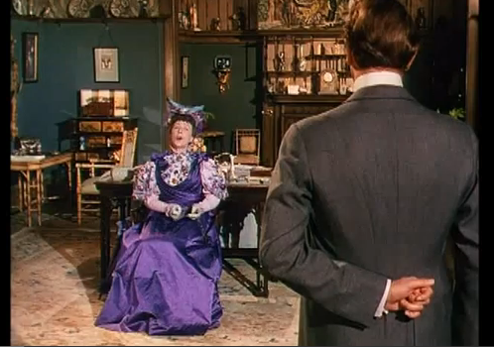
“Wit”/L’esprit: Oscar Wilde was famous for his witty writing and “bons mots”.
In the above text extract, a certain number of phrases have been highlighted:
Can you explain why they may be considered humorous or witty?
Which of the following techniques does Wilde use to increase the wit of his characters’ remarks in this scene?
Are you amused by Wilde’s characters? Do you laugh at their language, at their behaviour, or at the situations in which they find themselves?

Slide 8
ANALYSIS
Lady Bracknell is looking for specific qualities in her daughter’s future husband, who will of course be a perfect gentleman.
Do the following attributes correspond to the views she expresses in her interview?
If necessary, correct the following statements:
A gentleman should be idle.
He should be very well-educated.
It does not matter if he is rich or poor.
He should be from an aristocratic family.
Now rate these attributes in order of importance for Lady Bracknell.
“

Slide 9
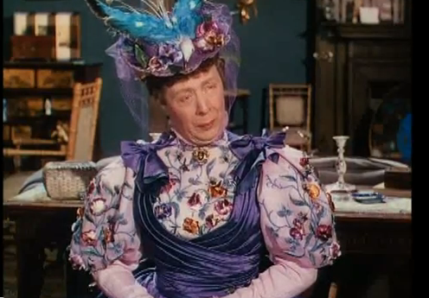
A girl brought up with the utmost care”
Lady Bracknell refuses to consent to the marriage of her daughter Gwendolen with Mr Worthing. Gwendolen has been brought up with the “utmost care” (the most possible care) and she refuses to sacrifice this to an unworthy alliance.
In view of the opinions she expresses in the scene, what do you think Lady Bracknell really means by the “utmost care”? Choose from the following list and explain your choice(s):
Love
Education
Food and diet
Expense

Slide 10
ROLE PLAY
IN PAIRS, perform your own contemporary language version of this scene.
Include at least one thought-track to reveal what you think each character is really thinking.

Slide 11
CONTEXT OF THE PLAY
The Importance of Being Earnest, A Trivial Comedy for Serious People is a play by Oscar Wilde. First performed on 14 February 1895 at St. James's Theatre in London, it is a farcical comedy in which the protagonists maintain fictitious personae in order to escape burdensome social obligations.
Working within the social conventions of late Victorian London, the play's major themes are the triviality of marriage, and the resulting satire of Victorian ways.
Its high farce and witty dialogue have helped make The Importance of Being Earnest Wilde's most enduringly popular play.

Slide 12
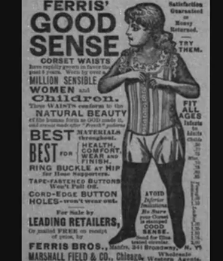
Victorian England
Wilde’s play is set in the 1890s. The upper class were expected to abide by a set of strict social rules to “save face”.
Look at the following videos and make a list of the social expectations and obligations that affected the behaviour of the upper class in Victorian England.
Etiquette Expert
Victorian Guide to Women
(this one is sarcastic)
Courting in the Victorian Era
Student-made video (poor quality, but good info)

Slide 13
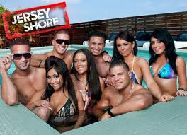
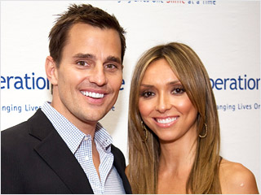
Wilde’s Purpose
Who is Oscar Wilde writing about in The Importance of Being Earnest?

Slide 14
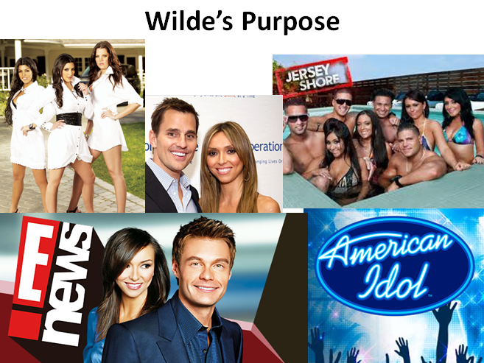
“Celebrity Culture”
Today, people seem concerned with the lives of the rich (sometimes upper class) and famous.
Click for Video
Discuss: Why are so many people interested in the lives of celebrities (why do so many watch “E News” and read Celebrity gossip magazines)?
Are the ways that the people act on TV (in public) genuine or “just for appearances”?
Are the things that people do and they ways that they act on these show realistic?

Slide 15
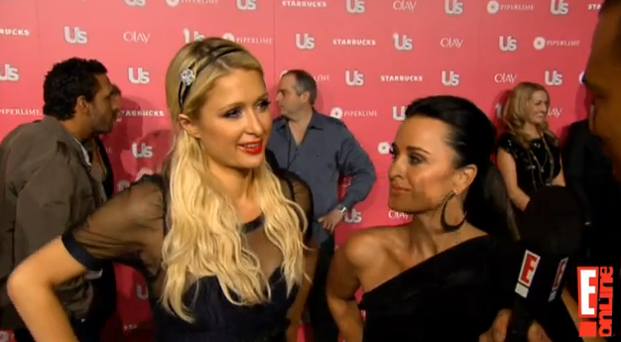
Watch the following “Red Carpet” interview with Paris Hilton and Joe Jonas…
What types of things are celebrities asked about? (what do they talk about?)
Are they sincere in what they say?
Do any of them contradict themselves?
Do any of them say anything negative?
Do they talk about anything important?

Slide 16
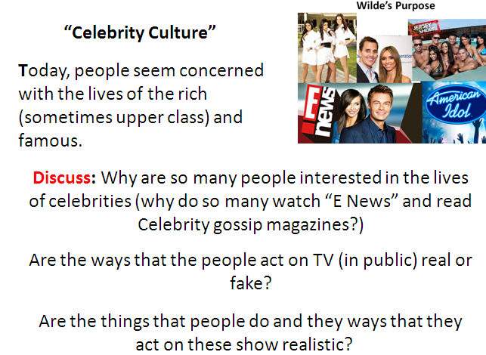
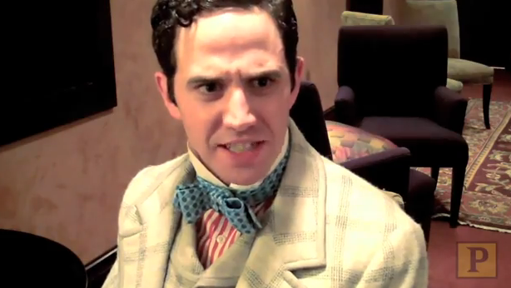
In the same way that we can view the public behaviour of celebrities today as fake…
Oscar Wilde was making the same comment in the play The Importance of Being Earnest.
Many of the main characters say ridiculous things, contradict themselves and present “fake” sides of themselves to society – this play relies on many non-sensical and silly statements in the dialogue to create humour.
Oscar Wilde Reads Jersey Shore!

Slide 17
ROLE PLAY
Within contemporary celebrity culture, events, feelings and emotions are described using either:
- triviality
- or overblown seriousness
When these two are juxtaposed (put closely together within the one conversation), the ridiculousness is emphasised.
TASK: Present a red-carpet interview with a celebrity…
Include in your interview questions about:
a recent deceased friend.
fashion.
charity.
a recent break-up

Slide 18
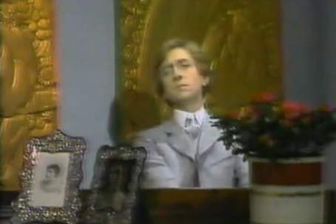
‘Algernon’
We are about to read up until page 7. In the opening of the play, we meet Algernon.
The Language of Algernon :
As we read through the first 7 pages, i) list words or phrases where trivial events are treated with overblown seriousness or where important events/topics are described with understatement.
You need to write down at least 6 quotes

Slide 19
ACT ONE
Algernon
Lane
Jack (Earnest)
Personality and Marriage in the first 20 pages
What is their attitude towards love and marriage?
Describe their personality
For each Character and column, find at least two quotes to fill in this table

Slide 20
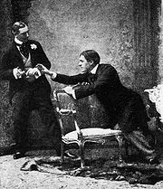
Euphemisms
Algernon invents a euphemism for leading a
double life, Bunburying. He says to his friend,
who is Earnest in town and Jack in the country,
“What you really are is a Bunburyist.” (Pg. 6)
Algernon explains that he invented a story about a sick friend, Mr. Bunbury, so he could retreat to a life of hedonistic pleasure at a moment’s notice. Thus, he coined the term Bunburying.
TASK:
Create a euphemism for something in your life that you would rather refer to in a more discreet manner.
Be sure to give an explanation of your euphemism and why you would use it.

Slide 21
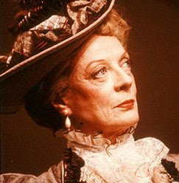
Read to the End of Act One…
Here, we meet the boisterous Lady Bracknell

Slide 22
Activity
The story in the play The Importance of Being Earnest unfolds through dialogue between the characters. The only narration comes in the form of stage direction.
Imagine you are Oscar Wilde, and you are rewriting the play as a novella. Rewrite the following passage from a third-person point of view.
Use more narration and less dialogue. Keep the tone and style of the original text:

Slide 23
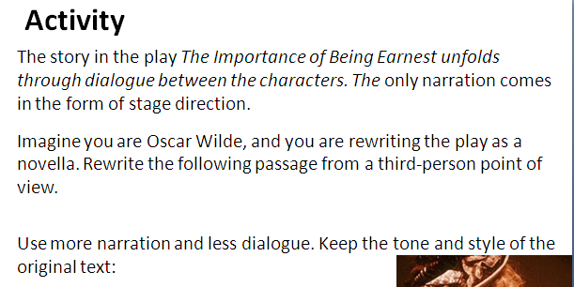
Lady Bracknell: And now I have a few questions to put to you, Mr. Worthing. While I am making these inquiries, you, Gwendolen, will wait for me below in the carriage.
Gwendolen [Reproachfully]: Mamma!
Lady Bracknell: In the carriage, Gwendolen!
[GWENDOLEN goes to the door. She and JACK blow kisses to each other behind LADY BRACKNELL’S back.
LADY BRACKNELL looks vaguely about as if she could not understand what the noise was. Finally turns round.]
Gwendolen, the carriage!
Gwendolen: Yes, mamma. [Goes out, looking back at JACK.]
LADY BRACKNELL [Sitting down]. You can take a seat, Mr. Worthing. [Looks in her pocket for note-book and pencil.]
Jack: Thank you, Lady Bracknell, I prefer standing. (Pg. 12)

Slide 24
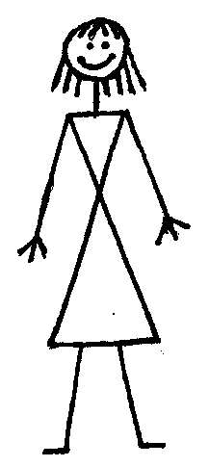
Pages 22-37
Read up until the end of Act 1 as a group.
In this section, we meet Lady Bracknell and Gwendolen.
Judgmental
- “…it is most indecorous” (p.27)
DRAW – a picture of Lady Bracknell in the middle of your page…
Label around her descriptions of her personality
(and include a quote beside each label that exemplifies it)

Slide 25
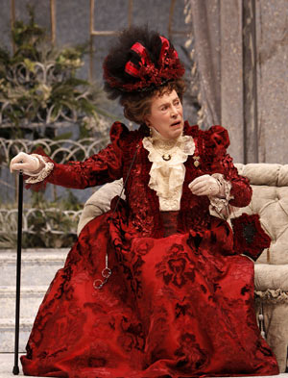
Women in Act 1
How are women in Act 1 shown to have the “upper hand”? (Explore more than simply what happens on stage.)

Slide 26
Oscar Wilde’s Society
What ideas do you gain about ‘society’ from your reading of the first Act?
Find quotations relating to status, behaviour and morality, and culture.

Slide 27
End of Act 1 – Dramatic Tension
Many events have taken place in a short period of time by the end of Act 1. How do the following act/facts “set up” the narrative for tension later in the play?:
Jack’s “adoption” being found in a bag in Victoria Station
Lady Bracknell (Gwendolen’s Mother), objecting to “Jack’s origins”.
“Bunburying”
Gwendolen’s obsession with the name “Ernest”
Cecily
Algernon reading his shirt cuff (last action in Scene 1)
Explain the significance of your given term.
Outline: i)The meaning of the term/phrase, ii) the context of the phrase, iii) the implications of the term phrase, and iv) predict what will happen in Acts 2 and 3 as a result of this term/phrase.
You must speak for one minute

Slide 28
Act 2: Cecily
Read pages 21 to the top of page 22 (until “I don’t see why you should keep a diary at all”) WE MEET CECILY
How do Miss Prism and Cecily regard Jack?
What is Miss Prism’s relationship to Cecily?
How do Miss Prism and Cecily regard Earnest?
Read from the top of page 22 to the top of page 26 (until “Perhaps she followed us to the schools”) CECILY MEETS “EARNEST” (ALGERNON)
Who is Dr Chasuble?
How does Algernon (pretending to be Earnest) speak to Cecily?
How does Cecily speak to Algernon?

Slide 29
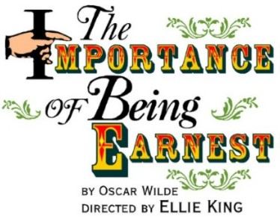
WHAT IS THE SIGNIFICANCE?:
“I hope you have not been leading a double life, pretending to be wicked and being really good all the time. That would be hypocrisy”.
Who said this to whom? Context of the quote? Why is this dramatic irony? Why is this quote meaningful in terms of the whole play?

Slide 30
Act 2: Cecily
Read FROM THE TOP OF PAGE 26 TO THE TOP OF PAGE 28 (until “…of an extremely obvious kind”) JACK’S LIE
Summarise Jack’s lie in 30 words or less.
Why does he tell this lie?
Read to the middle of page 34 (until “I’ll be back in no time”) CECILY AND “EARNEST” (ALGERNON) DECLARE THEIR LOVE
What is Jack’s reaction to seeing Algernon?
How long (in Cecily’s mind) have they been engaged?
What is the significance of the letters that Cecily wrote?

Slide 31
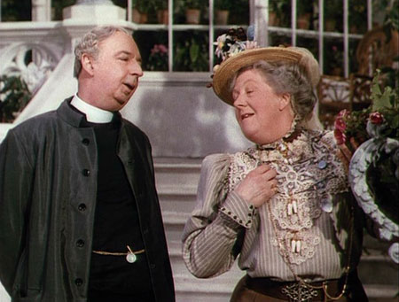
Miss Prism and Dr Chasuble
After reading up to page 34, what impression do you get of these two “older” characters in the play?
Discuss and (using bullet points) write down “facts” about each of their personalities – support each point with a quote.

Slide 32
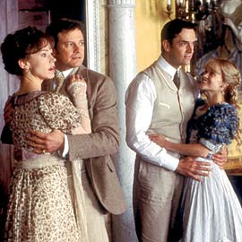
DRAMATIC IRONY
How does dramatic irony create humor in The Importance of Being Earnest? Identify a handful of instances FROM Act 2 so far in which the audience members know more about what is going on than the characters on stage.
Why does this create humor?
Two Hints:
“Earnest has been telling me about his good friend Mr Bunbury” (p.29)
“Poor Earnest, he had many faults, but it is a sad, sad blow” (p.26)

Slide 33
OBJECTIVE
Discuss the “relative morality” of the key characters and why we like/dislike them.
Examine how Humour is created in the Act 2 conversation between Cecily and Gwendolyn…

Slide 34
(ALMOST) END OF ACT 2 REVIEW
Think: Does the play lead us to make a moral evaluation of the characters’ behaviour?
You are going to be asked to place each character on the “morality spectrum” below.
Firstly, discuss what criteria you should use to determine someone’s “level of morality”:
Least Moral
Most “Moral”
Algernon Jack Cecily Gwendolyn Lady Bracknell
Miss Prism Dr Chasuble Lane Merriman

Slide 35
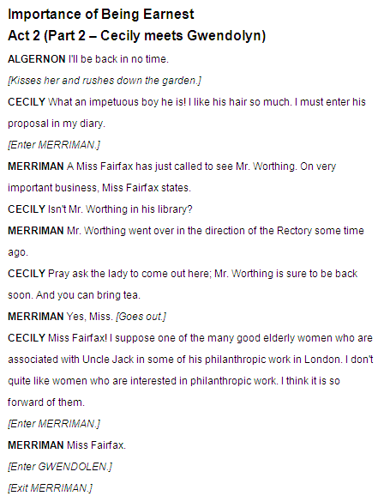
Act 2 (Part 2) Gwendolyn meets Cecily
Look at your copy of this meeting and complete the following tasks by i) annotating your copy of the script and ii) answering questions in your book.
TASKS:
Read through this scene in a group. As you read, annotate using one colour: Any overstatement or understatement by either character.
Highlight with a big !*! Where you think the highest point of tension is.
Highlight with a RED pen any insult (either explicit or implicit) said by Gwendolyn
Highlight with a BLUE pen any insult (either explicit or implicit) said by Cecily.

Slide 36
OBJECTIVE
Discuss the “relative morality” of the key characters and why we like/dislike them.
Examine how Humour is created in the Act 2.

Slide 37
END OF ACT 2 REVIEW
With a partner re-enact the following three Key Scenes from the play so far (join up each one with a cross-cut):
Lady Bracknell denies Jack permission to marry Gwendolyn
In this scene, use a freeze to highlight the highest point of tension
Cecily explains to Algernon their “engagement” (and his letters).
In this scene, include a thought-track from each character showing what they are really thinking.
Cecily and Gwendolyn meet
You can paraphrase each scene – just make sure you re-enact the main “point” of each scene.

Slide 38
“6 Paired Characters”
Jack (“Earnest”) Gwendolyn
Dr Chasuble Miss Prism
Algernon (“Earnest”) Cecily
Describe the relationship between each pair in 30 seconds or less.

Slide 39
A Farce:
A light dramatic work in which highly improbable plot situations, exaggerated characters, and often visual elements are used for humorous effect.
Find at least 3 quotes that exemplify these characteristics within the play…
highly improbable
plot situations
Exaggerated
characters
humorous effect

Slide 40
MOCKING THE INSTITUTIONS
In the characters Lady Bracknell, Miss Prism and Reverend Chasuable, Wilde can be seen to be commenting on the institutions of Aristocracy, Education (schools) and Religion (The Church).
Look at Lady Bracknell’s conversation with Jack (p.12-14). How is the aristocracy represented?
The Aristocracy:
Look at Miss Prism’s conversation with Cecily (p.21-23). How is formal education represented?
Education:
Look at Rev. Chasuble’s conversation with Miss Prism and Jack (p.26-28). How is formal Religion (The church) represented?
Religion:

Slide 41
17th September 2012
Objective:
Summarise/Read until the end of the play.
Examine how Wilde creates humour through the use of i) contradictions and ii)over/understatement.

Slide 42
In your last lesson…you performed 3 “Key Scenes”.
Re-enact these, using only 10 words per character per key scene, connected with a spinning crosscut…
Add a forth (30 second) scene to this: Show what happens from the top of p.38, to the end of Act 2 (p.42) (Jack and Algernon re-enter, Cecily and Gwendolyn retire inside)
You must use the words:
Muffins Bunburying Tea-cake

Slide 43
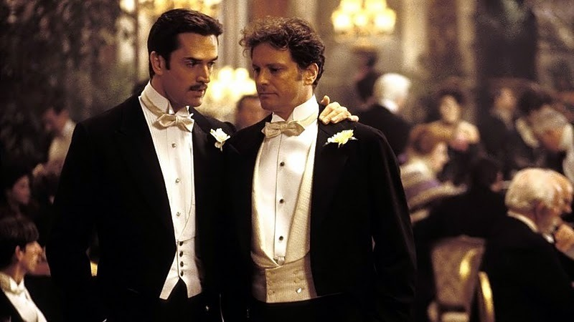
REFRESH:
One way that Wilde creates humour:
triviality
juxtaposed
overblown seriousness
ridiculousness
(under-statements about “serious” things)
- overblown seriousness (over-statements about “small” things).

Slide 44
As discussed regarding the character of Algernon, we have seen that much of his speech is characterised by 2 things:
- triviality (under-statements about “serious” things)
- overblown seriousness (over-statements about “small” things).
When these two are juxtaposed (put closely together within the one conversation), the ridiculousness is emphasised.

Slide 45
DRAMATIC CONTRADICTION
Two statements (or a statement and an action) that are juxtaposed that are said (or done) by the same character that contradict each other…
Example from Act 1:
Algernon: Please don't touch the cucumber sandwiches. They are ordered specially for Aunt Augusta.
(Takes one and eats it)

Slide 46
Group One: (page 43 - 45)
i) Provide a 3 sentence summary of the action that takes place.
ii) Re-enact 4 lines of dialogue that contain either over/understatement or a contradiction.
iii) Explain how this creates humour
Group Two: (page 46-48)
i) Provide a 3 sentence summary of the action that takes place.
ii) Re-enact 4 lines of dialogue that contain either over/understatement or a contradiction.
iii) Explain how this creates humour
Group Three: (page 49-51)
i) Provide a 3 sentence summary of the action that takes place.
ii) Re-enact 4 lines of dialogue that contain either over/understatement or a contradiction.
iii) Explain how this creates humour
Group Four: (page 52-54)
i) Provide a 3 sentence summary of the action that takes place.
ii) Re-enact 4 lines of dialogue that contain either over/understatement or a contradiction.
iii) Explain how this creates humour

Slide 47
SUMMARY OF ACT 3
You have now seen 4 “pieces” of Act Three.
As a group, provide a summary of the action that takes place in Act 3
(at least 5 sentences. Everyone in the group must have a copy in their book)
Homework: Read Act 3 by Thursday’s lesson!

Slide 48
OBJECTIVE
Examine how Wilde creates an overall impression of: MARRIAGE
Stakeholder Discussion:
Situation:
A young couple, Lauren and Will (both 23 years old) have decided to become married. Only one of them has full-time work. To be married and to live together (and to be closer a place of employment) they have to live a considerable distance away from their friends and families.
You will be put in the following groups:
Group A: Lauren’s parents
Group B: Lauren’s (girl)friends
Group C: Will’s friends
Group D: Lauren
Group E: Will
Group F: Will’s parents
In your group, prepare a summary of what you would say about :
The advantages of them getting married,
The disadvantages of them getting married.
Your final advice on marriage for Lauren and Will.

Slide 49
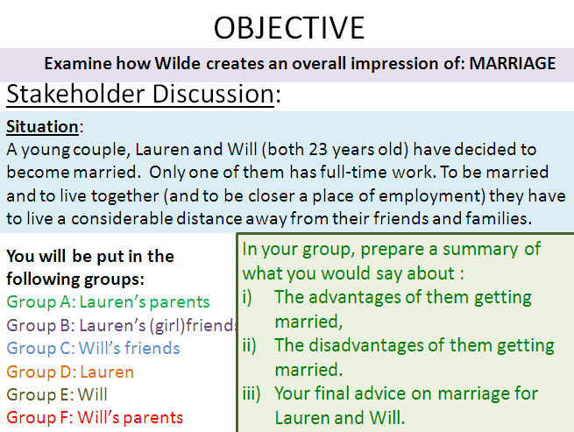
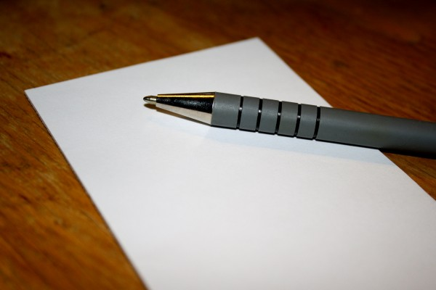
MARRIAGE
As you have seen, there are many views on the role, purpose, advantages and disadvantages of marriage:
MAKE A LIST:
What are the reasons that people get married TODAY?:
MAKE A LIST:
What are the reasons that people get married in IOBE?:

Slide 50
Marriage in IOBE
A paradox is a statement or group of statements that leads to a contradiction or a situation which (if true) defies logic or reason.
We are going to examine several quotes from The Importance of Being Earnest that concern marriage.
As you probably already know, Wilde presents a paradoxical view on marriage

Slide 51
Quote Hunt
In pairs, you will be given a quote about marriage from IOBE.
Find the quote
Explain the context of the quote (who says it, when do they say it, what are they saying it in response to).
What opinion of marriage does the quote seem to reinforce?
Create an A3 poster (Headlined either Negative or Positive) which includes:
Images of the main characters involved in the scene.
The key part of the quote about marriage written clearly.
Information about the context and location of the quote.

Slide 52
Quite a few of your posters say “Negative”…now contrast this
with the actual narrative:
Who in the story wants to get married?
Who doesn’t want to get married?
The fact that all the main characters want to get married, yet they speak about marriage as if it is a “bad” thing is called VERBAL IRONY (where a character says the opposite of the truth)

Slide 53
CHARACTER STUDY
You are going to produce a large poster for each of the characters in TIOBE.
One paradoxical quote from this character
Name of Character
One “over-stated” quote from this character.
One “under-stated” quote from this character.
A description of the action that this character plays in the overall narrative (50-100 words)
An overall description of their personality and how their actions affect the dramatic tension
(50-100 words)

Slide 54
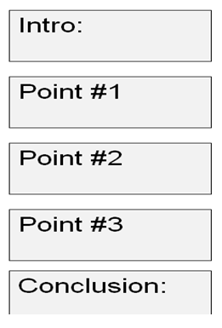
MOCK EXAMINATION QUESTION
How does Oscar Wilde present the institution of marriage in The Importance of Being Earnest?
In your group on a large A3 sheet of paper, collect at least 3 quotes (you can use the ones from your “Quote Hunt”) .
Turn each of these into a full
PEE Paragraph.
Don’t worry about an Intro/Conclusion
at this stage…

Slide 55
How does Oscar Wilde present the institution of marriage in The Importance of Being Earnest?
Intro:
Now, individually, in your books write a full essay response:
Each box represents a full paragraph.
Point #1
Point #2
Point #3
Conclusion:

Slide 56
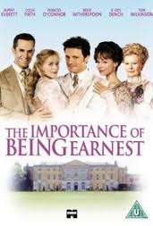
Objective: Examine how the play IOBE creates it’s characterisation.
Key Question: How important are the stage directions, costumes and props in the presentation of the characters?

Slide 57
IOBE is a “dialogue-driven” play.
Discuss what this term means.
There are very few stage directions/costume descriptions in the play – where does most of the characterisation come from?
Watch the following adaptation of IOBE:
Your teacher will pause the text after each key conversation.
Discuss/answer these three question after each “pause”.
Has the setting affected our understanding of any of the characters?
Has the costume affected our understanding of any of the characters.
Has any actors interpretation of any character’s lines affected/differed from your own ideas about any character?

Slide 58
Course Work/Examination Preparation
In the next 5 double lessons, you are going to create two pieces of coursework that could be used for your coursework portfolio.
i) One Analytical Essay
ii) One empathetic writing piece.
Discuss the difference between the two…

Slide 59
i) Analytical Coursework.
Written in third person
PEE Paragraphs
Use (well-selected) quotes
Clear Introduction and Conclusion
At least 3 well-made points.
Formal/academic register.
Intro:
Point #1
Point #2
Point #3
Conclusion:

Slide 60
i) Empathetic Coursework.
Written in first person – from the perspective of a character in the play.
Paragraphs used – each paragraph has a clear topic/subject (NOT PEE)
You must show knowledge of specific events in the play.
You must show an accurate/realistic empathetic response from your character (show how they “feel” in response to the events you mention).
Try to re-create the voice, tone and register of the character (play with the language so that it “sounds” like the character.
At least 5 paragraphs.

Slide 61
How does Oscar Wilde comment on and present the aristocracy in his play The Importance of Being Earnest ?
How is Food used within the play The Importance of Being Earnest to communicate meaning to the audience?
What is the significance of the full title of the play The Importance of Being Earnest: A Trivial Comedy for Serious People?
What are the possible symbolic roles of Rev. Chasuble and Miss Prism in the play The Importance of Being Earnest?

Slide 62
You are Lady Bracknell at the end of Act One. Explain your reasons for not allowing Earnest to Marry Gwendolyn (Hint: include some foreshadowing to help reveal Lady Bracknell’s true character.
You are Cecily. You have gone inside with Gwendolyn after finding out about the fictional Earnest. Write your thoughts about what has and will happen…
You are Algernon. You have just learned of your engagement to Cecily and have gone to see Dr Chasuble about being christened. What are your thoughts as you walk along?
You are Merriman at the end of the play. What do you make of the afternoon’s proceedings?

Slide 63
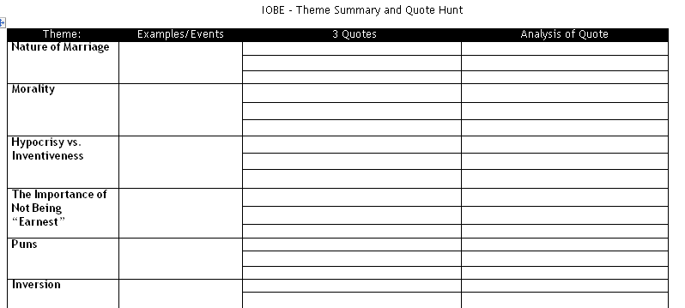
Revision – Themes.
You will be given a brief summary of one of the themes of the play IOBE.
TASK: Collaboration and presentation with/to other small groups.
Explain your theme and summary.
Find 3 examples of characters/events that exemplify this theme.
Pick three quotes from the play and explain how they exemplify the Theme.
Use this sheet to help you take notes.
(You are going to have to share your information with other groups soon, so make sure your notes are concise AND MAKE SENSE TO YOU)

Slide 64
Now – you are going to have your original information sheet taken away from you. You will have approximately 5 minutes with each group in the room to share and exchange your information with each other.
Make sure you verbally explain to them what your theme/topic means…

Slide 65
QUIZ - THEMES
You have now had a chance to discuss these themes…
One student will be picked at random to speak for at least 25 seconds on one of the following topics:
Hypocrisy vs. Inventiveness
Fiction and Writing
Nature of Marriage
Food
The Importance of Not Being “Earnest”
Puns
Death
“The Double Life”
Inversion
Morality

