Slide 1
Year 11 IGCSE Mock Exam Preparation
Literature Paper
Language Papers

Slide 2
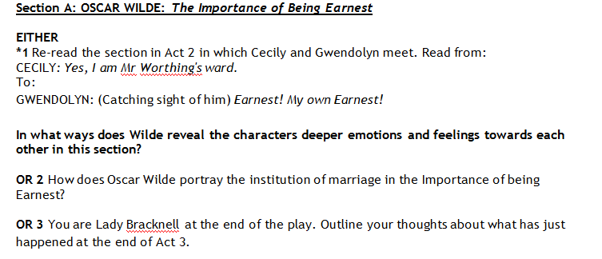
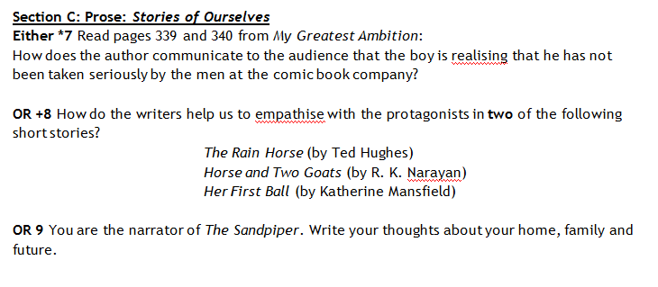
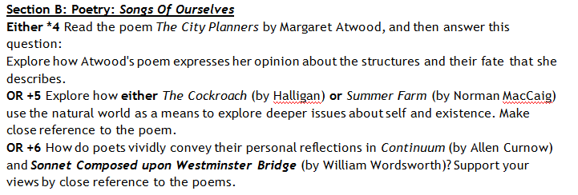
Literature Paper 1
3 sections – i) a Play, ii) Poetry and iii) Prose.
The Importance of being Earnest, Songs of Ourselves and Stories of Ourselves (Short Stories)

Slide 3
Language Paper 2
3 questions – i) Text Transformation, ii) Selecting effective quotes and iii) Summarising.

Slide 4
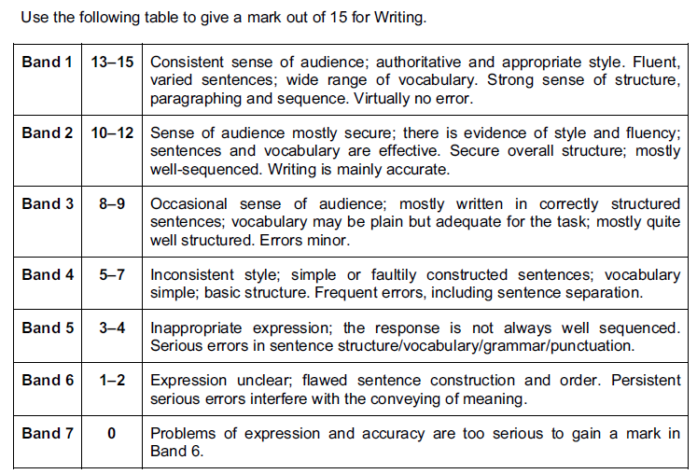
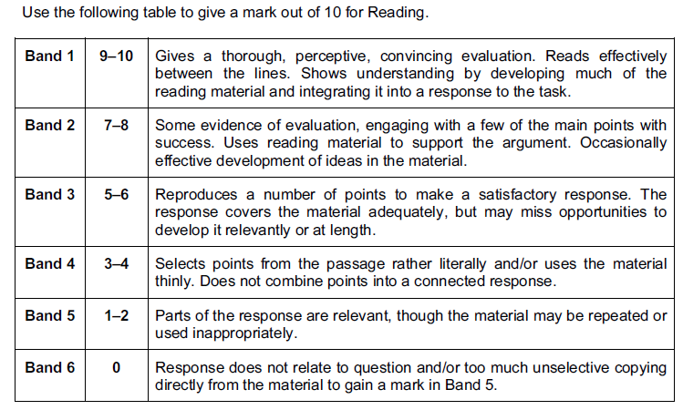
Language Paper 3
QUESTION ONE: Directed Writing.
You will be given a text (it could be anything - article, interview, diary etc) that will be expressing some form of opinion.
Just like Paper 2, Q1: You will have to do a text transformation (it could be anything - article, interview, diary etc ) in which you summarise and evaluate the arguments (and possible counter arguments) in the text.
You have to write 2 sheets of paper

Slide 5
Look at your own copy of these criteria for Question 1. Make a list of 10 “Dos” for your response to Question One.

Slide 6
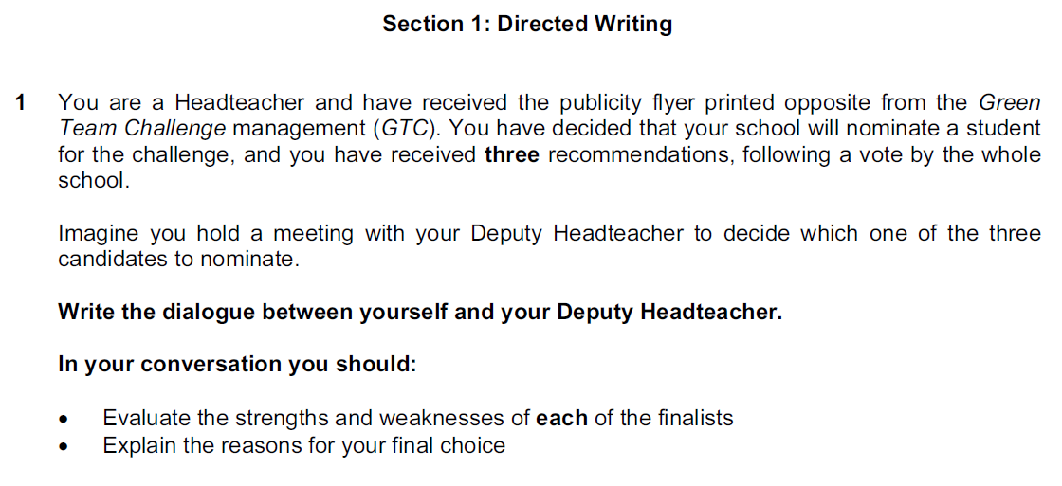
Sample Question One

Slide 7
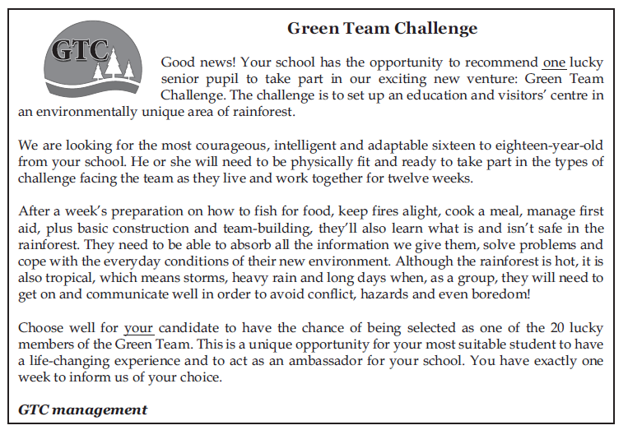
Sample Question One

Slide 8
In your group (now, before you have even read about the 3 student candidates), plan an outline for your written response:

Slide 11
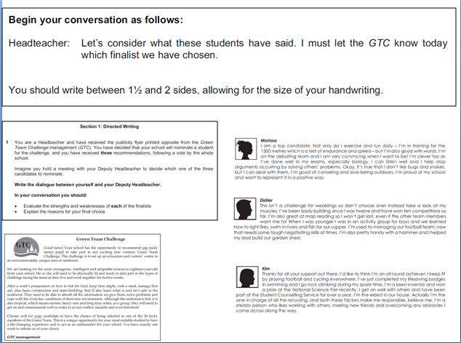
TAP
Text?:
Audience?:
Purpose?:
In your group, write your response to this question

Slide 12
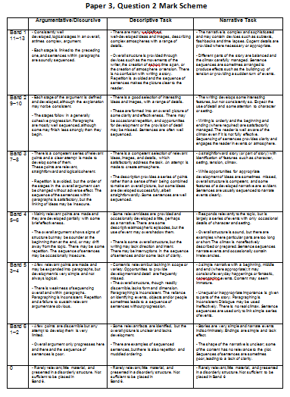
Language Paper 3
QUESTION TWO: Composition .
You can choose between writing an argumentative/discursive piece OR a descriptive piece OR a Narrative piece that is two pages long:
You will be put into one of three groups.
Argumentative/Discursive
Descriptive
Narrative
Look at your copy of the criteria sheet for Table A and write a 5-7 item list of “To Dos” for your question type.

Slide 13
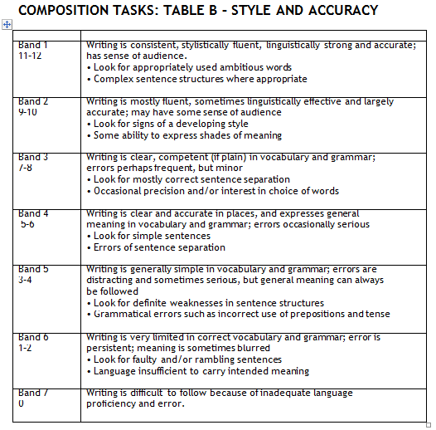
Look at your copy of the criteria sheet for Table B and write a list of “To Dos” for your question type.

Slide 14
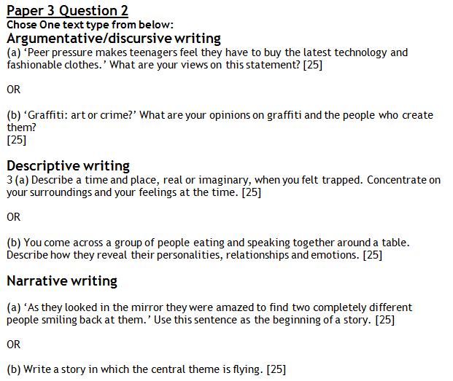

Slide 15
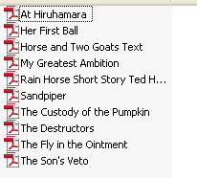
LITERATURE – Short Stories
Go to:
Q:\Secondary Students\English\Year 11 2013 Mocks\Pre 2013 Mock
Look at all of the Short Stories that will be on the examination.
In groups, create a concept map that shows how the stories link together thematically.

Slide 16
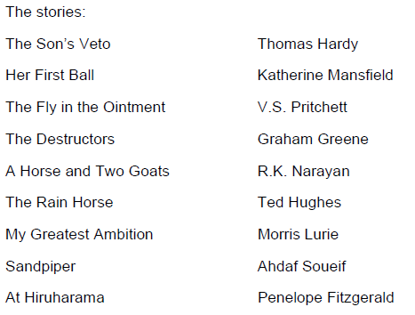
LITERATURE - Poetry
Go to:
Q:\Secondary Students\English\Year 11 2013 Mocks\Pre 2013 Mock
Look at all of the Poems that will be on the examination.
In groups, create a concept map that shows how the stories link together thematically.

Slide 17
LITERATURE – Play (IOBE)
Go to:
Q:\Secondary Students\English\Year 11 2013 Mocks\Pre 2013 Mock
Look at all of the Short Stories that will be on the examination.
In groups, create a concept map that shows how the stories link together thematically.

Slide 18
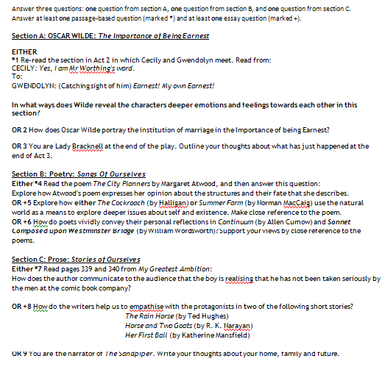
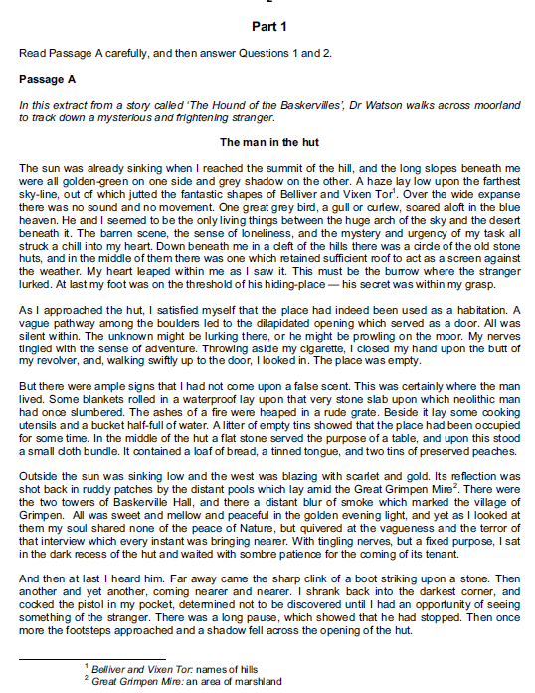
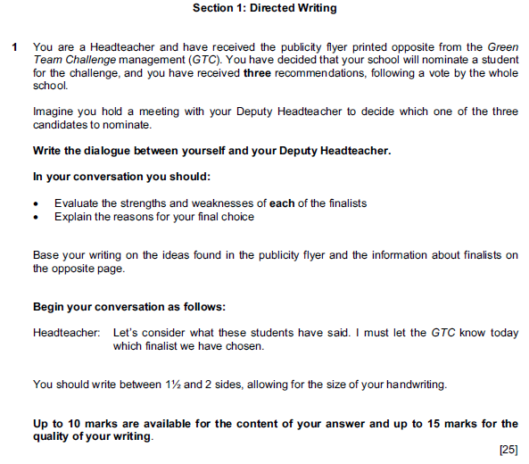
TASKS for TODAY
Literature Paper:
- Complete any of the questions on the Literature practice paper.
Language Paper 2:
- Complete any of the questions on the practice paper (Hound of the Baskervilles)
Language Paper 3:
- Complete any of the questions on the practice paper (2009)

